Slide 1
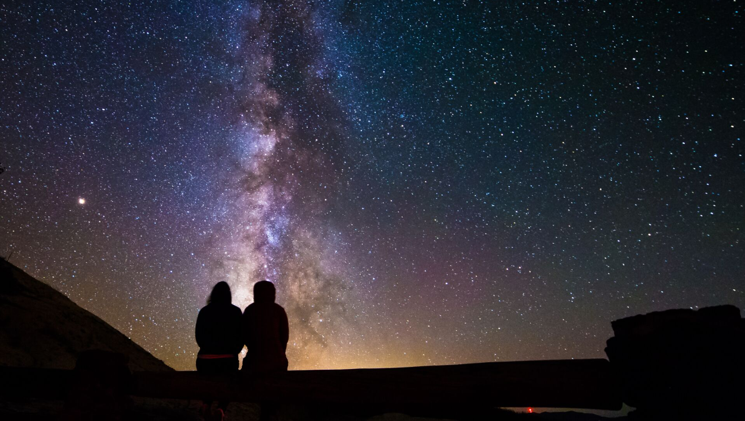

Artificial Light at Night
Impacts to Birds and other Animals
Trish Cutler
State Council
NM Chapter of DarkSky International
Notes:
Introduction

Slide 2
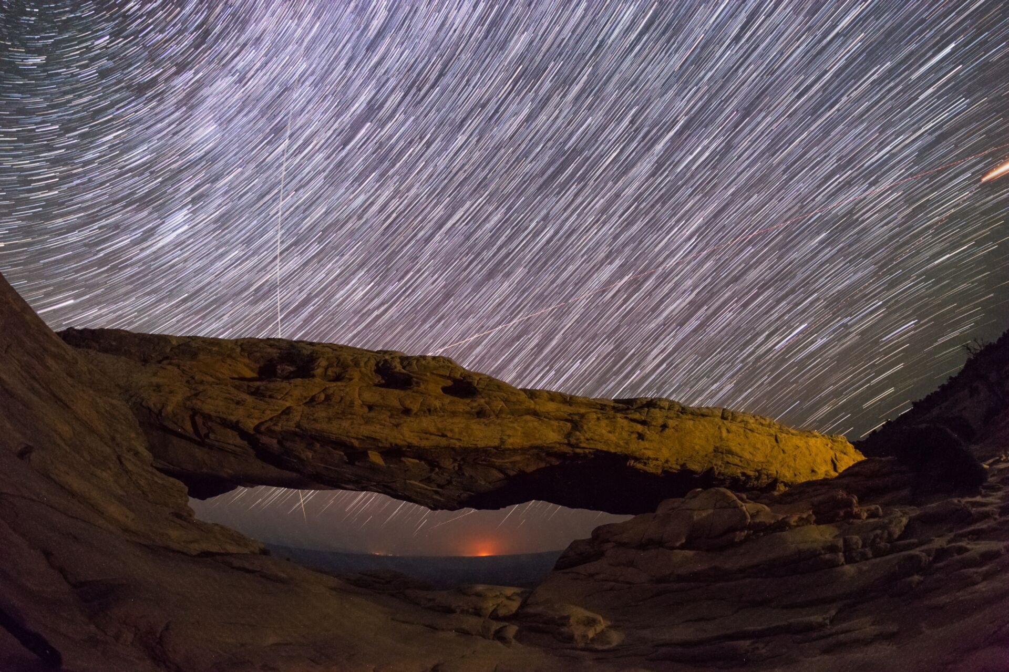
“ONLY IN THE DARKNESS CAN YOU SEE THE STARS”
–MARTIN LUTHER KING JR.
DarkSky International | 2024
Notes:
Why does darkness matter? Well, its only in the darkness that we can see the stars and the planets, which are awe-inspiring and important for our wellbeing.
But darkness is becoming more and more difficult to experience. My parents grew up on ranches in NE Wyoming, and my Mom likes to remind me, “Trish, people these days have no idea of what a dark sky even looks like”. She’s so right, and we need to be thinking about preserving dark skies not only for us but for future generations.

Slide 3
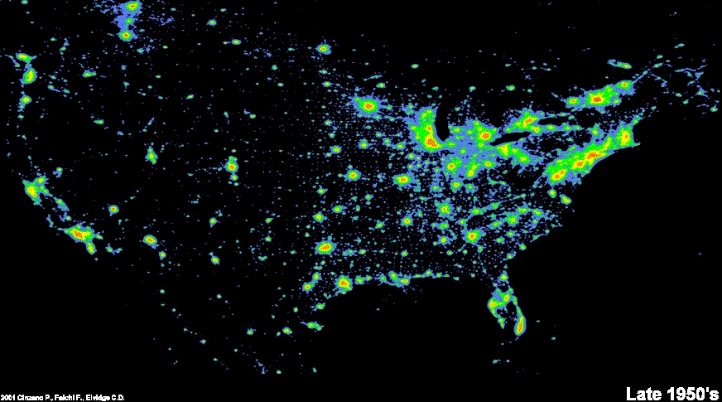
Light pollution is increasing at 9.6% per year*
*Per GloberatNight.org 2023 report
Notes:
Light pollution has been increasing rapidly! These images show the progression of artificial light at night as seen from space from the late 1950s to the present day. It’s not hard to imagine a world without any remaining natural darkness, at all, if we continue at our current rate.

Slide 4
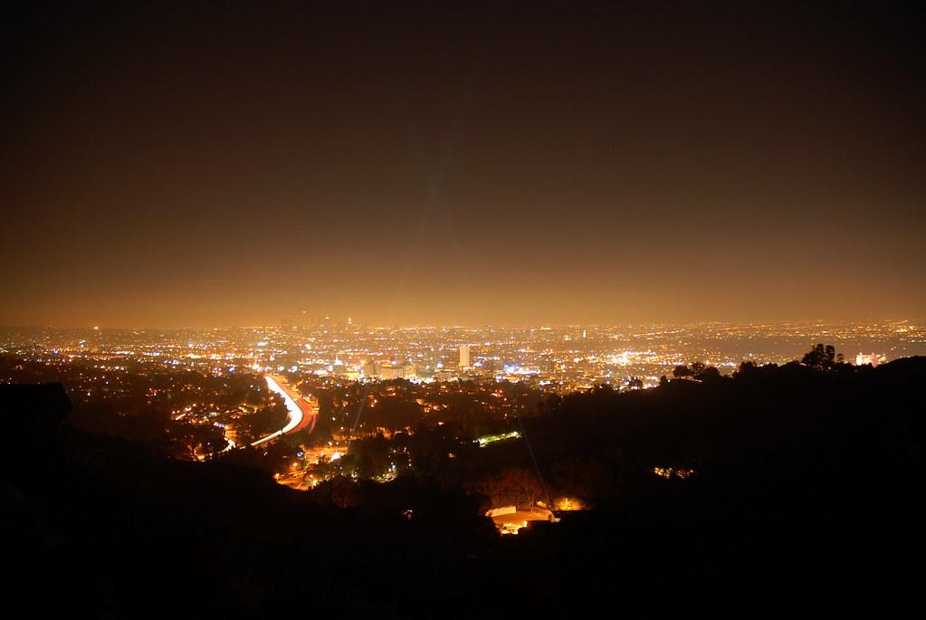
LIGHT POLLUTION
Any adverse effect on humans or other animals from artificial light at night.
Image: Mike Knell
DarkSky International | 2024
Notes:
What is light pollution? Any adverse effect on humans or other animals from artificial light at night.
It comes in 3 main forms, Skyglow, Glare, and Light Trespass.

Slide 5
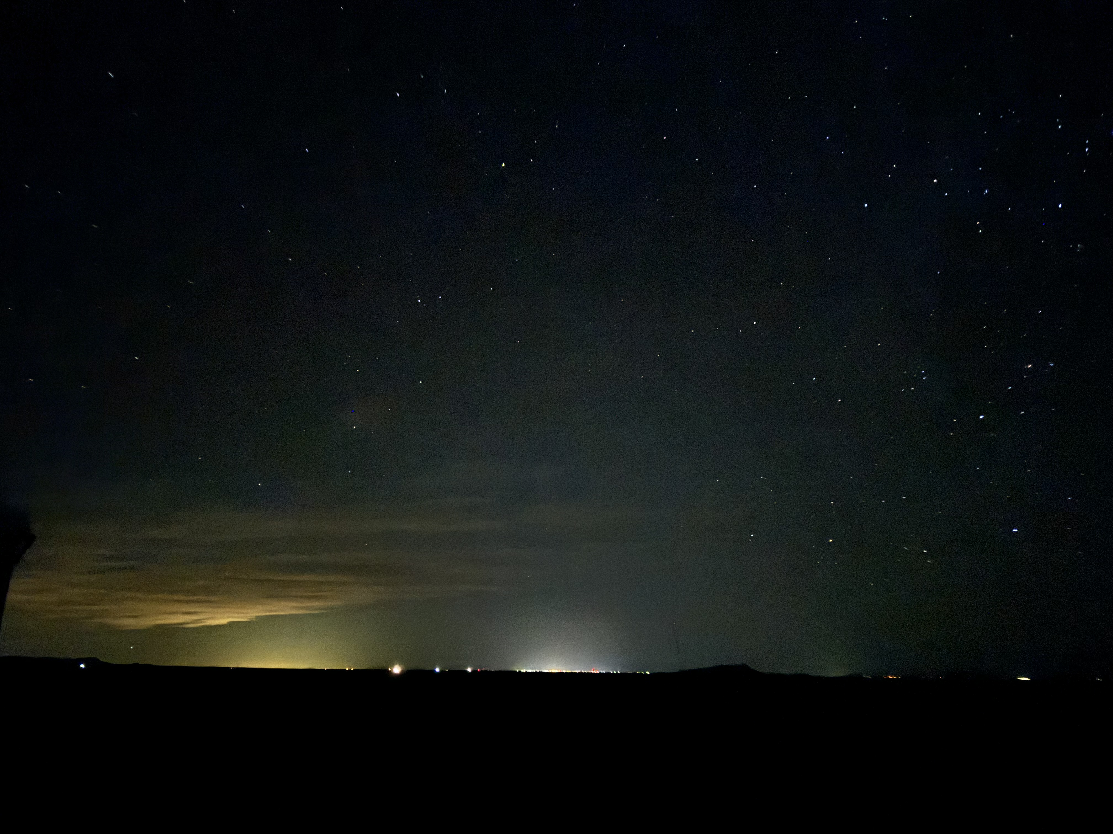
SKYGLOW
DarkSky International | 2024
Notes:
This photo was taken from the New Mexico Astronomy Village near Deming.
At the center is Deming from 22 miles away, and to the left is El Paso from 110 miles away.
You may ask “what’s the problem”? Well, without the sky glow, stars would be visible down to the horizon, and many MANY more stars would be seen in rest of the photo.

Slide 6
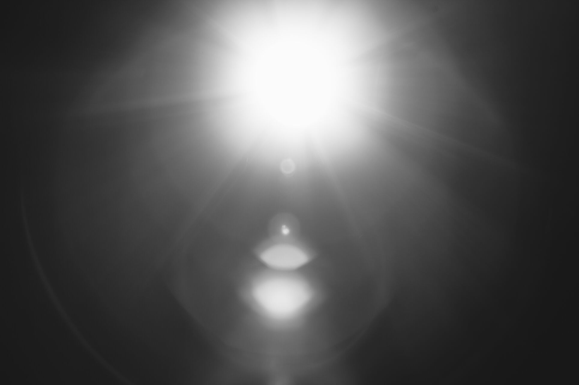
GLARE
DarkSky International | 2024
Notes:
We’ve all experienced glare from oncoming vehicles, bright unshielded floodlights, or a flashlight shined in our eyes. (Demo?)
Glare is when light enters our eyes at shallow angles, causing discomfort and restriction of the pupil, reducing visual acuity.
To make matters worse, commonly used LEDs are heavy in the blue/white light spectrum - causing even more impairment to our vision at night than historic light sources such as incandescent or high pressure sodium bulbs.

Slide 7
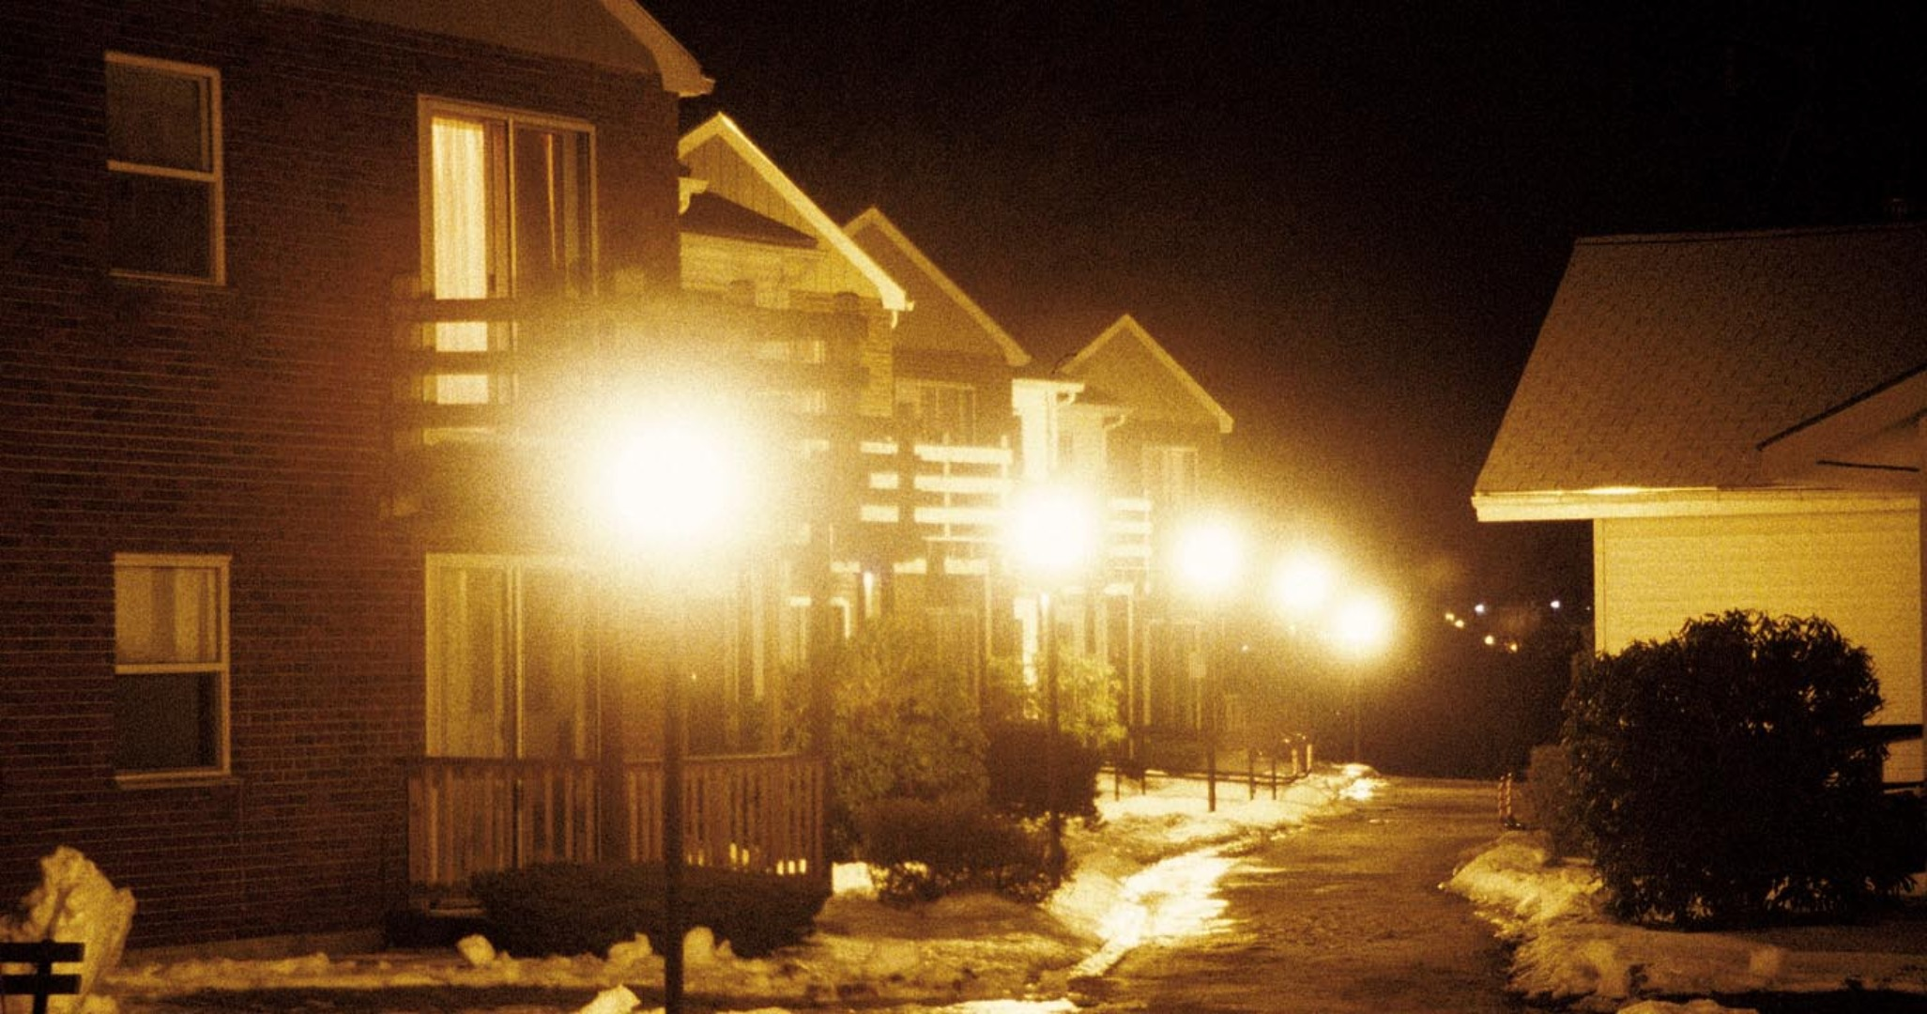
LIGHT TRESPASS
DarkSky International | 2024
Notes:
Light trespass occurs when light is falling outside of a property boundary onto another property or home.
Similar to noise, we can think of light trespass as a private property rights issue.
Trespass can also occur from street or parking lighting that is brighter than necessary, or unshielded.

Slide 8
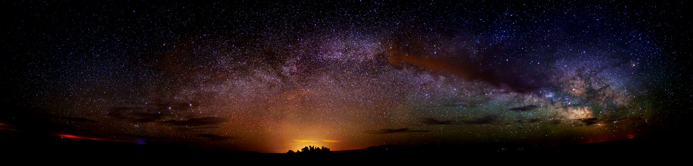
LIGHT POLLUTION CONSEQUENCES
DarkSky International | 2024
Notes:
So what are the consequences of light pollution?

Slide 9
ECOLOGICAL IMPACTS

Slide 10
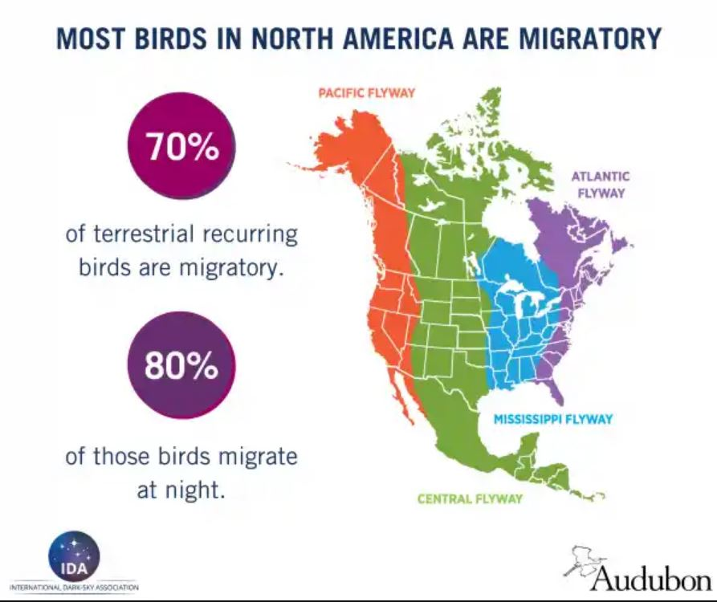
Most Bird Species in North America are Migratory
DarkSky International | 2024
Notes:
Bird SPECIES.
This means that the majority of birds are exposed to artificial light during migration, which is already the most challenging and stressful part of their life cycle. During migration, birds are experiencing extreme physical activity, with a limited amount of stored body fat from their breeding grounds, and increasing challenges to refuel at stopover sites. There isn’t much margin for error during migration.

Slide 11
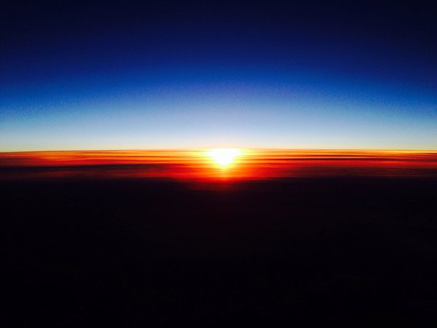
• Day length is a cue for timing of migration • Sky glow affects navigation • Attraction, capture, and collision
Spring/Fall Bird
Migration
Beyond Bird
Migration
• Habitat avoidance • Change in circadian rhythms • Other phenology shifts
• Altered predator/prey relationships
DarkSky International | 2024
Notes:
Not only are birds affected during migration, but artificial light affects birds and other animals (including humans) throughout the year.
During migration…
Day length is a cue for the onset of migration north, so if ALAN obscures day length it could affect the timing of migration which is critical for successful migration and reproduction.
Sky glow affects navigation
Nocturnal migrants use a variety of cues to navigate accurately, so artificial light can be disorienting.
When taking off at sunset, birds use the plane of polarized light from the sun to calibrate their internal compass. Lab studies have shown that when the sunset was obscured, the accuracy of orientation was significantly reduced.
Celestial cues (moon/stars).
Attraction, capture, and collision.
On a smaller scale, lights can actually attract birds, resulting in “capture” and/or collision. Especially during inclement weather. Birds may fly around in circles until they drop to the ground in exhaustion, or collide with windows, guy lines, light poles, towers, or other infrastructure. Once on the ground, the bird is susceptible to starvation, dehydration, and predation.
There is data that estimates up to one hundred million to a billion birds die from collisions with buildings in North America each year, and light is the biggest factor for collisions that occur at night.
Circadian rhythm is the 24 hour clock that describes an animal’s cycles of sleep, blood pressure, metabolism, hormone secretion, alertness and reaction time, cardiovascular efficiency, and many other functions.
Insects particularly attracted to the blue-rich lighting of LEDs.

Slide 12
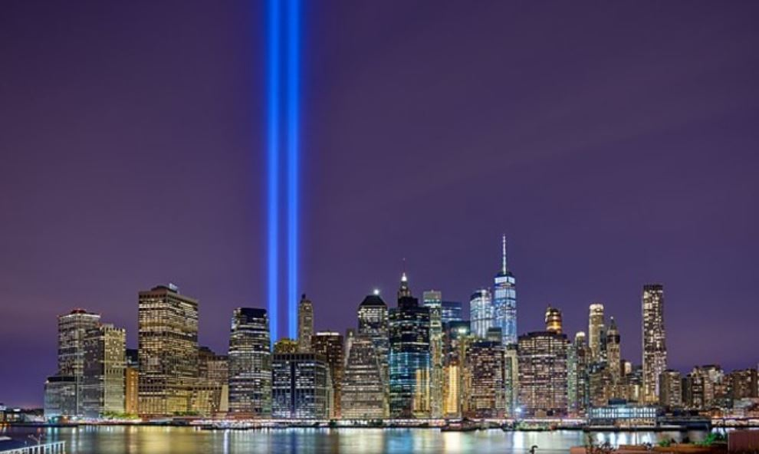
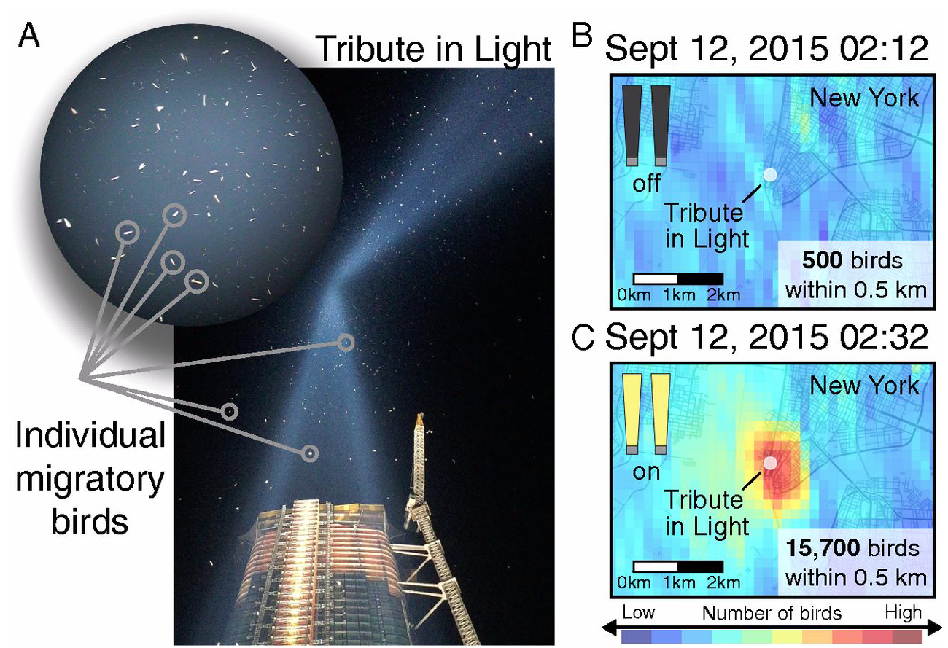
National 9/11 Memorial & Museum Tribute in Light
Van Doren et al. 2017. High-intensity urban light installation dramatically alters nocturnal bird migration.
DarkSky International | 2024
Notes:
The NYC Tribute in Light is a great example of the capture of birds by light.
The display includes 88 high-intensity spotlights pointed straight up at the sky, during fall migration.
Birds were becoming captured in the lights, and if the lights were not turned off they would become exhausted and fall to the ground.
NYC Audubon developed a mitigation to count birds every 20 min throughout the night, and when the number reaches 1,000 they extinguish the lights for 15-20 minutes to release the birds.
The radar image to the right shows the effect of lights on the birds when the lights are turned on. Within a 20 minute period the number of birds erupts from 500 to 15,700 birds captured by the display.
…

Slide 13
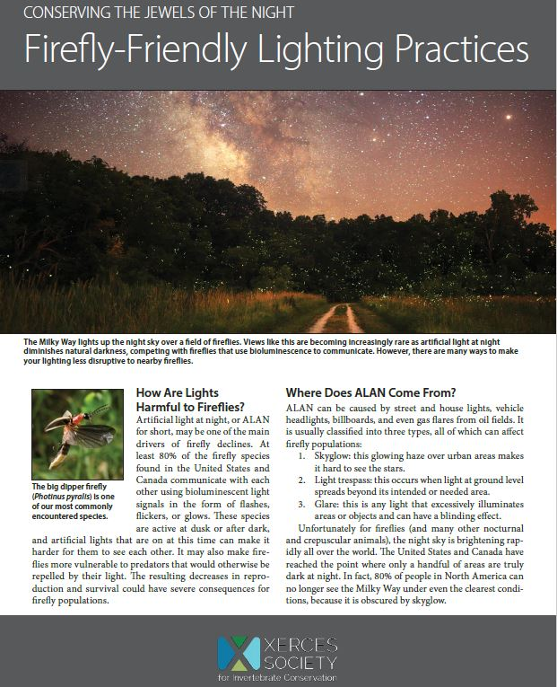
DarkSky International | 2024
Notes:
Artificial light affects invertebrates. We have at least 13 species of fireflies in NM, but did you know that they used to be found in Las Cruces and Albuquerque?
The reason for the disappearance of these populations is most likely due to habitat loss, pesticide use, and urbanization which increases light pollution. Globally, these are the main drivers of firefly declines. When the courtship flashes of fireflies are overpowered by artificial light, mating success is drastically reduced and eventually localized firefly populations can become extinguished.
---------------------------
There is no perfect light temperature to mitigate impacts on all fireflies, because fireflies of different species use slightly different wavelengths to communicate. Therefore, the best solution for fireflies is to minimize light brightness, direct light only where it is needed, and turn lights off when they are not in use.
Not all fireflies are the flashing kind that utilize a flash-response dialogue to find suitable mates; we also have diurnal dark fireflies (which still glow aposematically as eggs and larvae) and glow-worms, where the females glow to attract males passing overhead in the night. We have 5 flashing species, 4 glow-worm species, and 4 dark fireflies. Light pollution probably only really adversely impacts the first two groups.

Slide 14
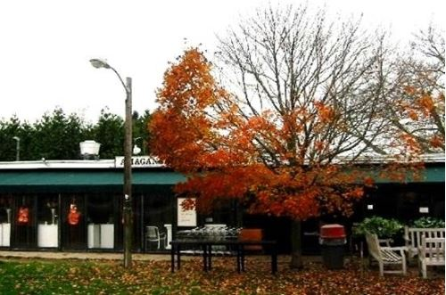
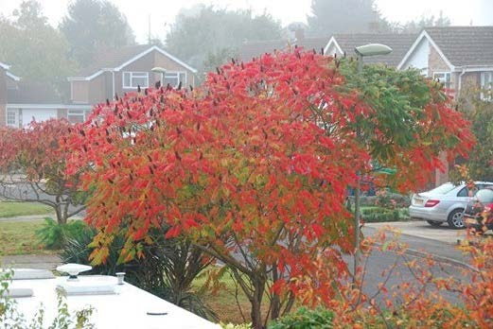
TREES
bud earlier and lose their leaves later under artificial light
DarkSky International | 2024
Notes:
Trees are even affected by light pollution! Those exposed to artificial light at night bud earlier, lose their leaves later, and have shorter lifespans. You can see how the distribution of light on these trees has affected their natural cycles.
Artificial light has also been shown to affect agricultural crops.

Slide 15
ENERGY WASTE

Slide 16
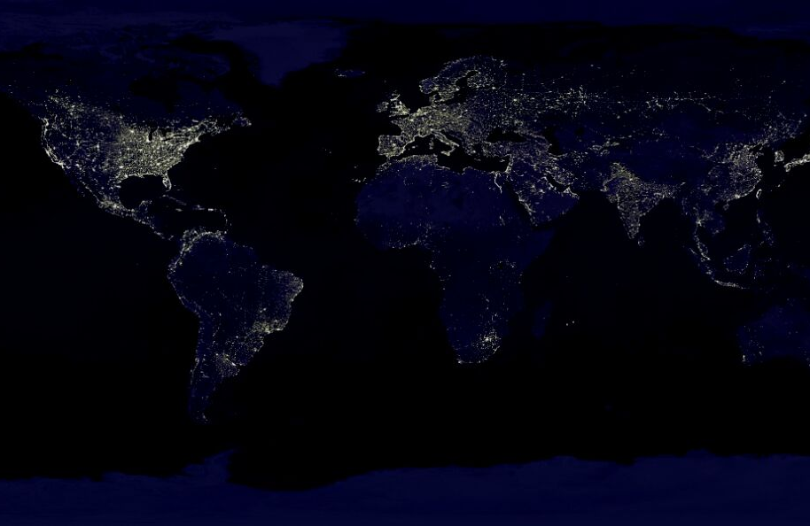
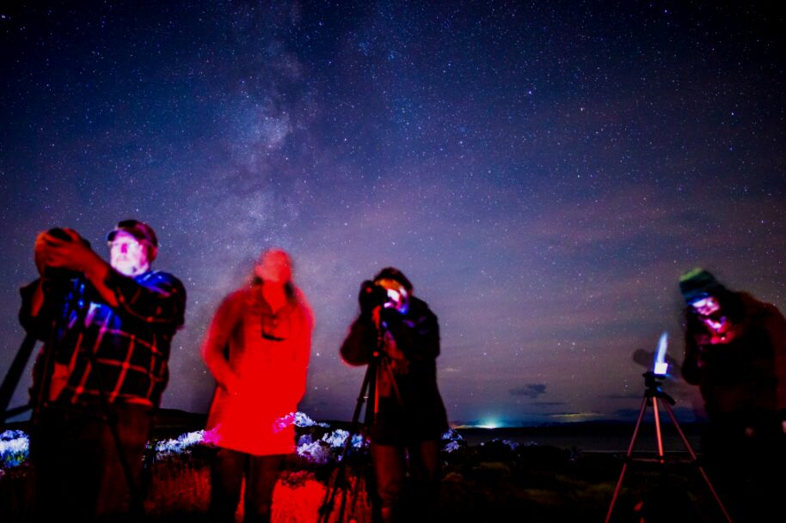
3-7 BILLION DOLLARS
spent every year on unneeded lighting
21 MILLION TONS OF CO2
burned by unnecessary lighting
The International Dark-Sky Association | 2019
DarkSky International | 2024
Notes:
Light pollution is also a waste of money and energy. About 35% of lighting worldwide is wasted light, shooting up into the sky. When we do the math, we spend around 3-7 billion dollars a year on wasted light, while adding 21 million tons of Carbon Dioxide to the atmosphere each year.
Can we really afford to be doing this while we struggle to combat climate change?

Slide 17
HUMAN HEALTH

Slide 18

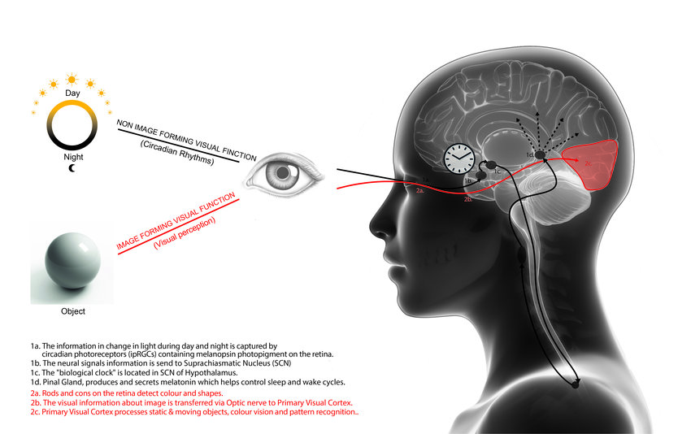
Concerns about LED street lighting
Disability Glare results in decreased visual acuity and reduced driving visibility.
A 4000K LED is emitted as blue light that the human eye perceives as a harsh white color. Our pupils constrict, and we can’t see as well. A “veil of illuminance” leads to discomfort and reduced visibility.
Eye Damage: Blue wavelengths create more scattering of light in the human eye and potential damage to retinas.
Disruption of Circadian Rhythm via melatonin suppression (LEDs 5x).
Secondary negative health effects from chronic sleep disruption: increased risk of cancer, diabetes, cardiovascular disease, and obesity.
Zielinska-Dabkowska and Xaviab. 2018. An overview of cognitive and biological effects of city niggtime illumination including a London case study.
DarkSky International | 2024
Notes:
In 2016, the AMA adopted guidance on the detrimental effects of LED street lights on human health.
I have noticed this myself. In my own neighborhood, people walk up and down the road at night with their dogs or for exercise. It is very difficult to see them when there is an oncoming car with LED headlights – even when not on bright lights.

Slide 19
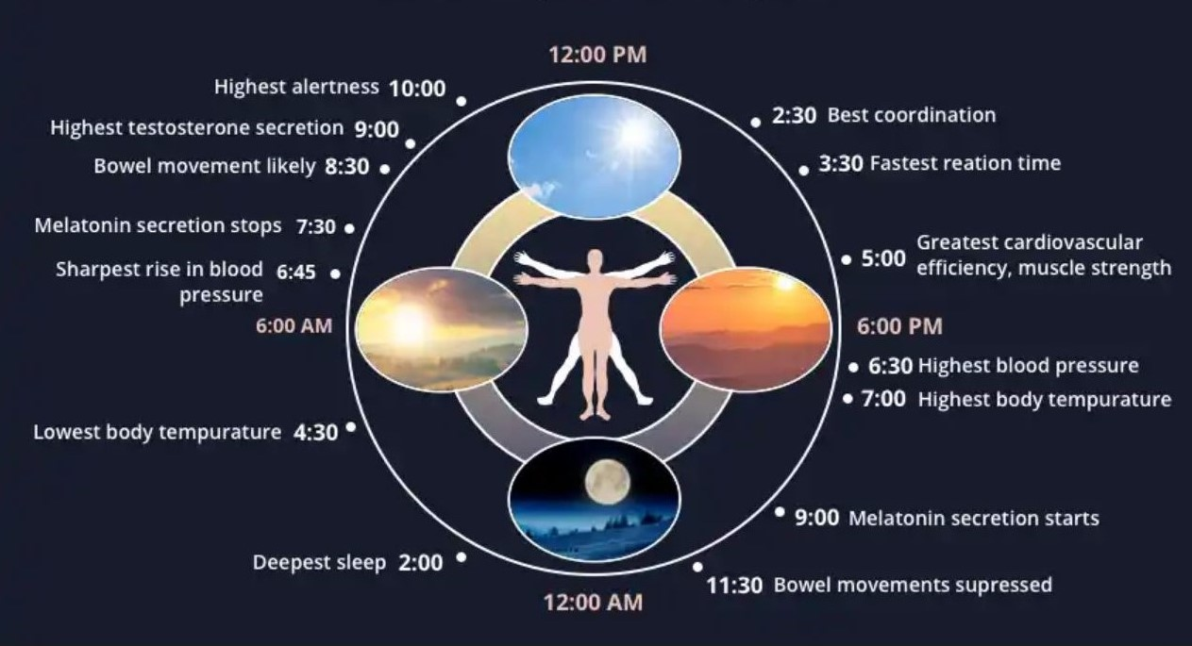
DarkSky International | 2024
Notes:
Humans evolved on this planet with reliable cycles of light and dark. The addition of light into what has always been darkness disrupts our natural circadian rhythm and the functions you see here. Our circadian rhythm is mediated by the hormone melatonin. Secretion is suppressed when we are exposed to light at night, specifically blue/white light that mimics what we experience under a daytime sun.
Blue/white LEDs have a strong spike at the wavelength of light that most effectively suppresses melatonin in our bodies. Brighter residential lighting is associated w/ reduced sleep time and quality, increased awakenings, daytime sleepiness, impaired daytime functioning, and obesity.
In fact, compared to the HPS lights that most LEDs are replacing, a white LED is estimated to have 5x the effect on melatonin suppression.

Slide 20
SAFETY AND SECURITY

Slide 21
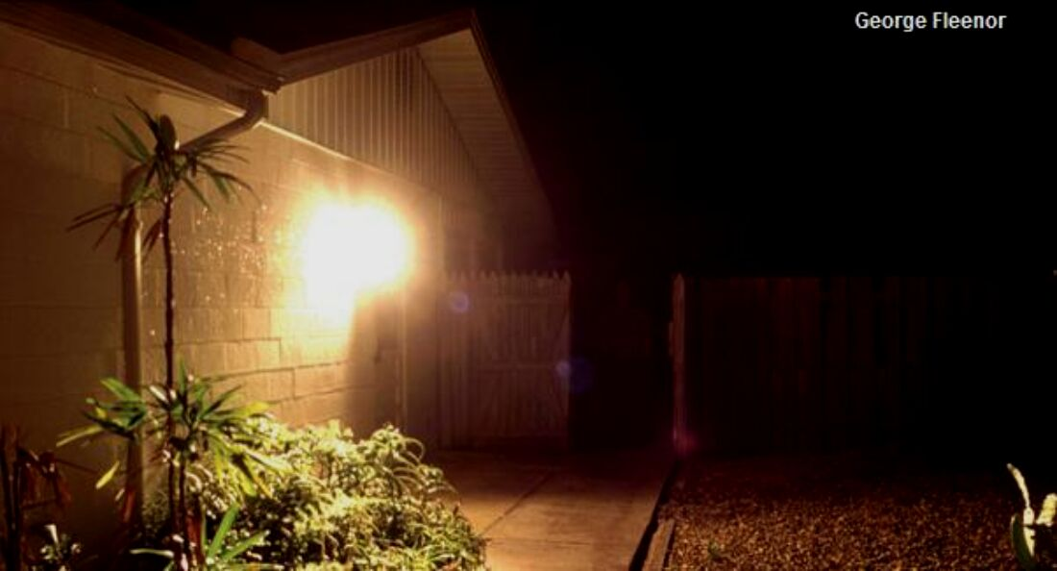
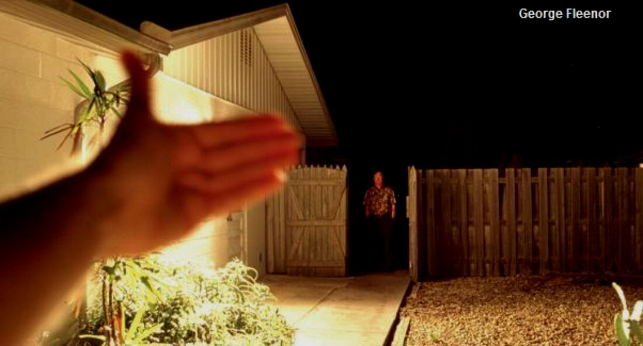
MYTH: MORE LIGHTING IS SAFER
REALITY: WELL DESIGNED LIGHTING IS SAFER
DarkSky International | 2024
Notes:
The wall pack mounted to this building is unshielded, causing unnecessary and uncomfortable glare. If you were exposed to this, your pupils would become restricted and your ability to see would be reduced.
This photo shows the improvement if the fixture was shielded. Your eyes aren’t assaulted, and you’re better able to see the intruder.

Slide 22
THE SOLUTION:
BETTER LIGHTING DESIGN
DarkSky International | 2024
Notes:
The good news is that light pollution is one environmental problem that is completely REVERSIBLE. And the solutions lie in better lighting design that can still provide the light we need for visibility and safety.

Slide 23
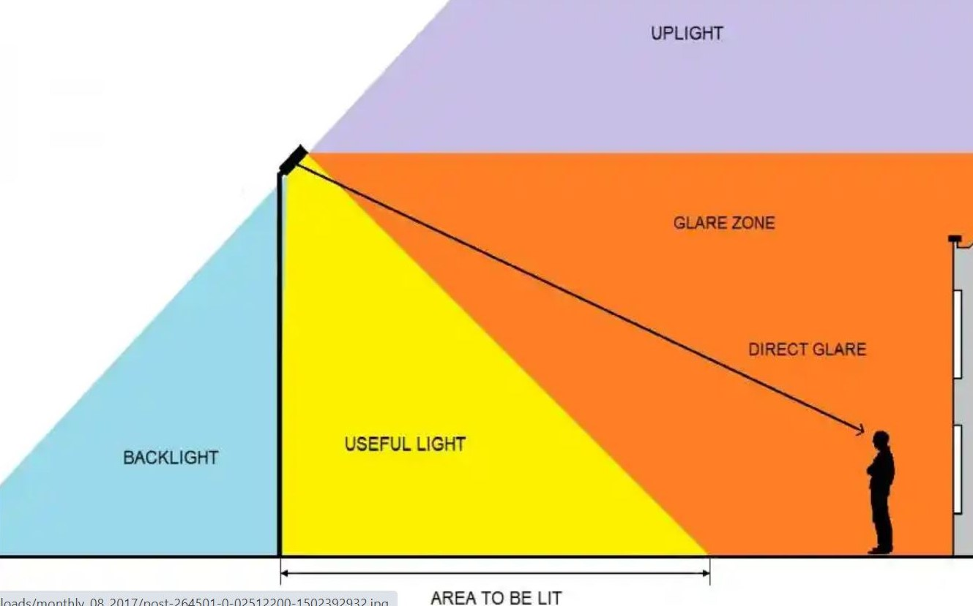
DarkSky International | 2024
Notes:
This illustration shows a problematic floodlight. What many people don’t realize is that if this light is tilted up an any angle above 0 degrees, it causes uplight and skyglow. The amount of light on the ground is greatly weakened, and the human in this picture is now subjected to glare.
And the uplight is now directly visible to nocturnal migrants.
This light was not designed to be used in this position, but manufacturers are selling them this way because people think they are lighting out to a farther distance. In some cases they are, but the amount of light on the ground is severely compromised.

Slide 24
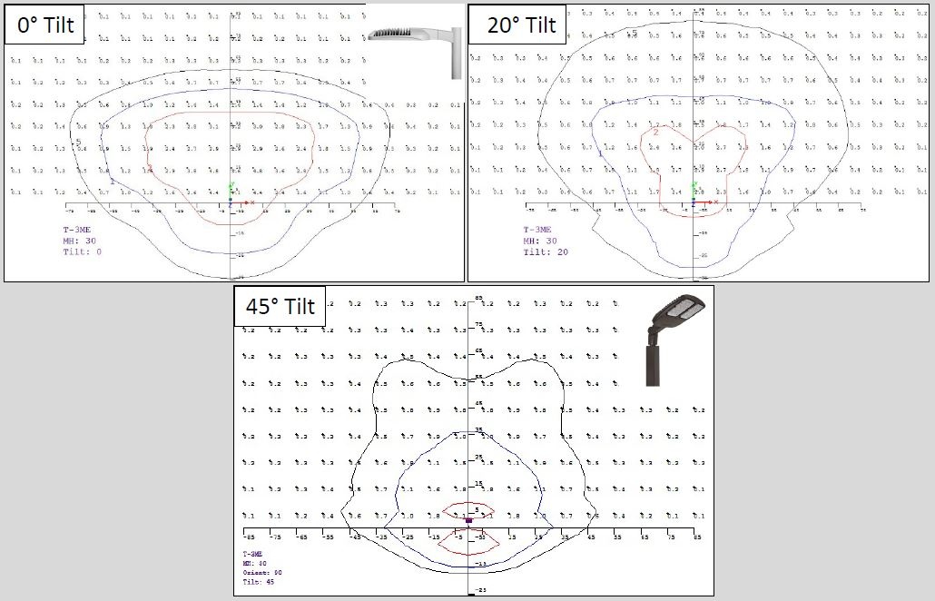
Tilt Creates Poor Quality Light on the Ground
4.4
2.9
2.1
DarkSky International | 2024
Notes:
When you tilt up a fixture that was designed to point straight at the ground, you lose a lot of light and energy to the sky where it isn’t needed and can cause harmful effects. You also create glare for humans on the ground.
Indicate that this is a view looking down from above the light pole, and the point out the light pole.
Here you can see how the brightness on the ground is greatly reduced, and the area covered becomes greatly distorted.

Slide 25
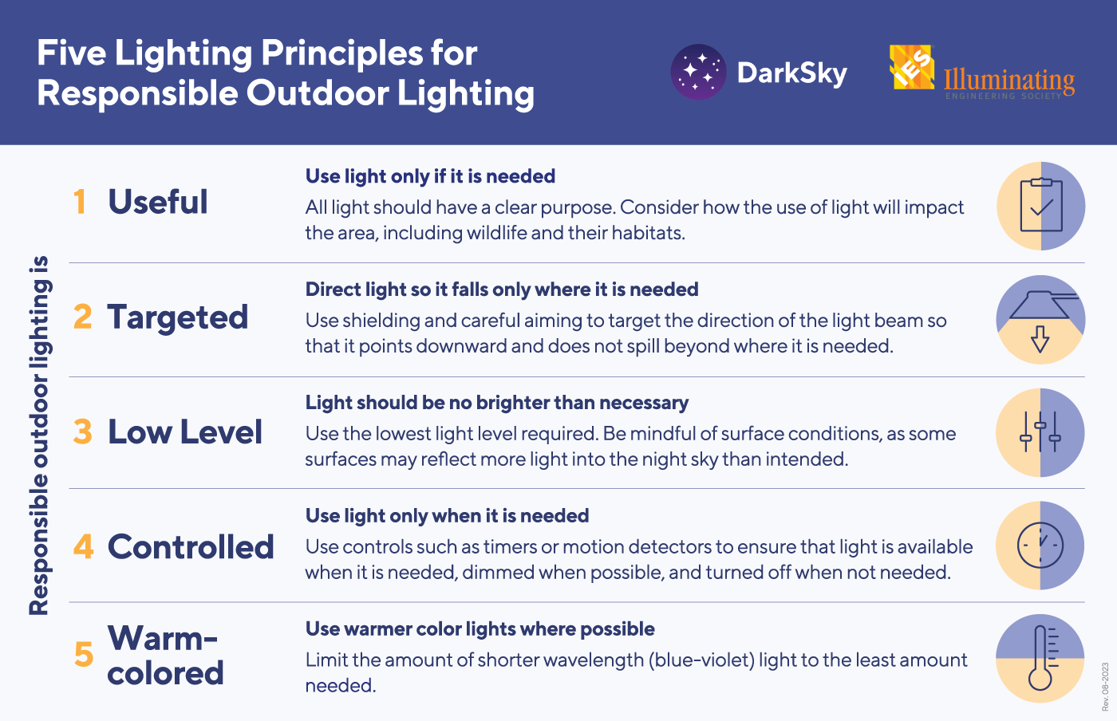
Notes:
The solutions are generally the same, whether you’re concerned about human health, safety/security, wildlife, energy conservation, or astronomy. And DarkSky International has condensed them down into these 5 principles of responsible outdoor lighting.
Useful - First decide if you really need the light. Is the lighting warranted?
If a light is there just to look pretty, perhaps turn it off and see pretty the natural night sky can be ☺

Slide 26
Notes:
Targeted

Slide 27
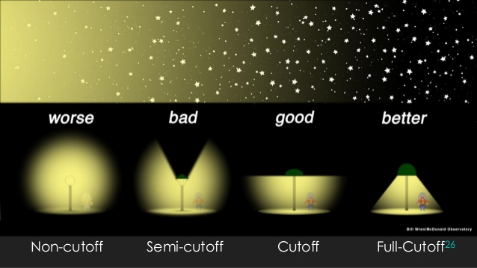
DarkSky International | 2024

Slide 28
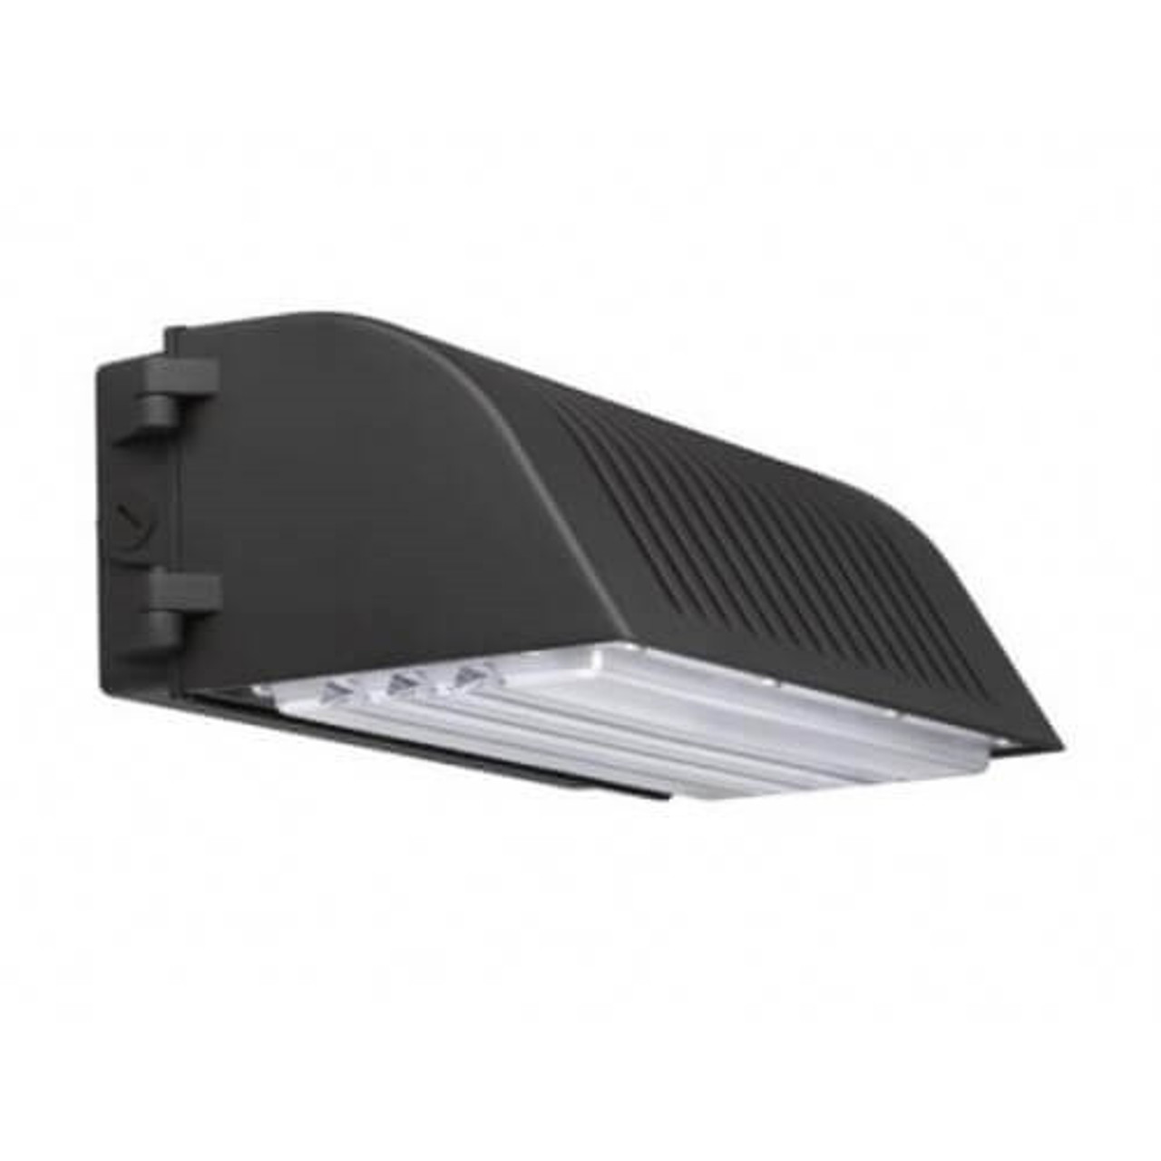
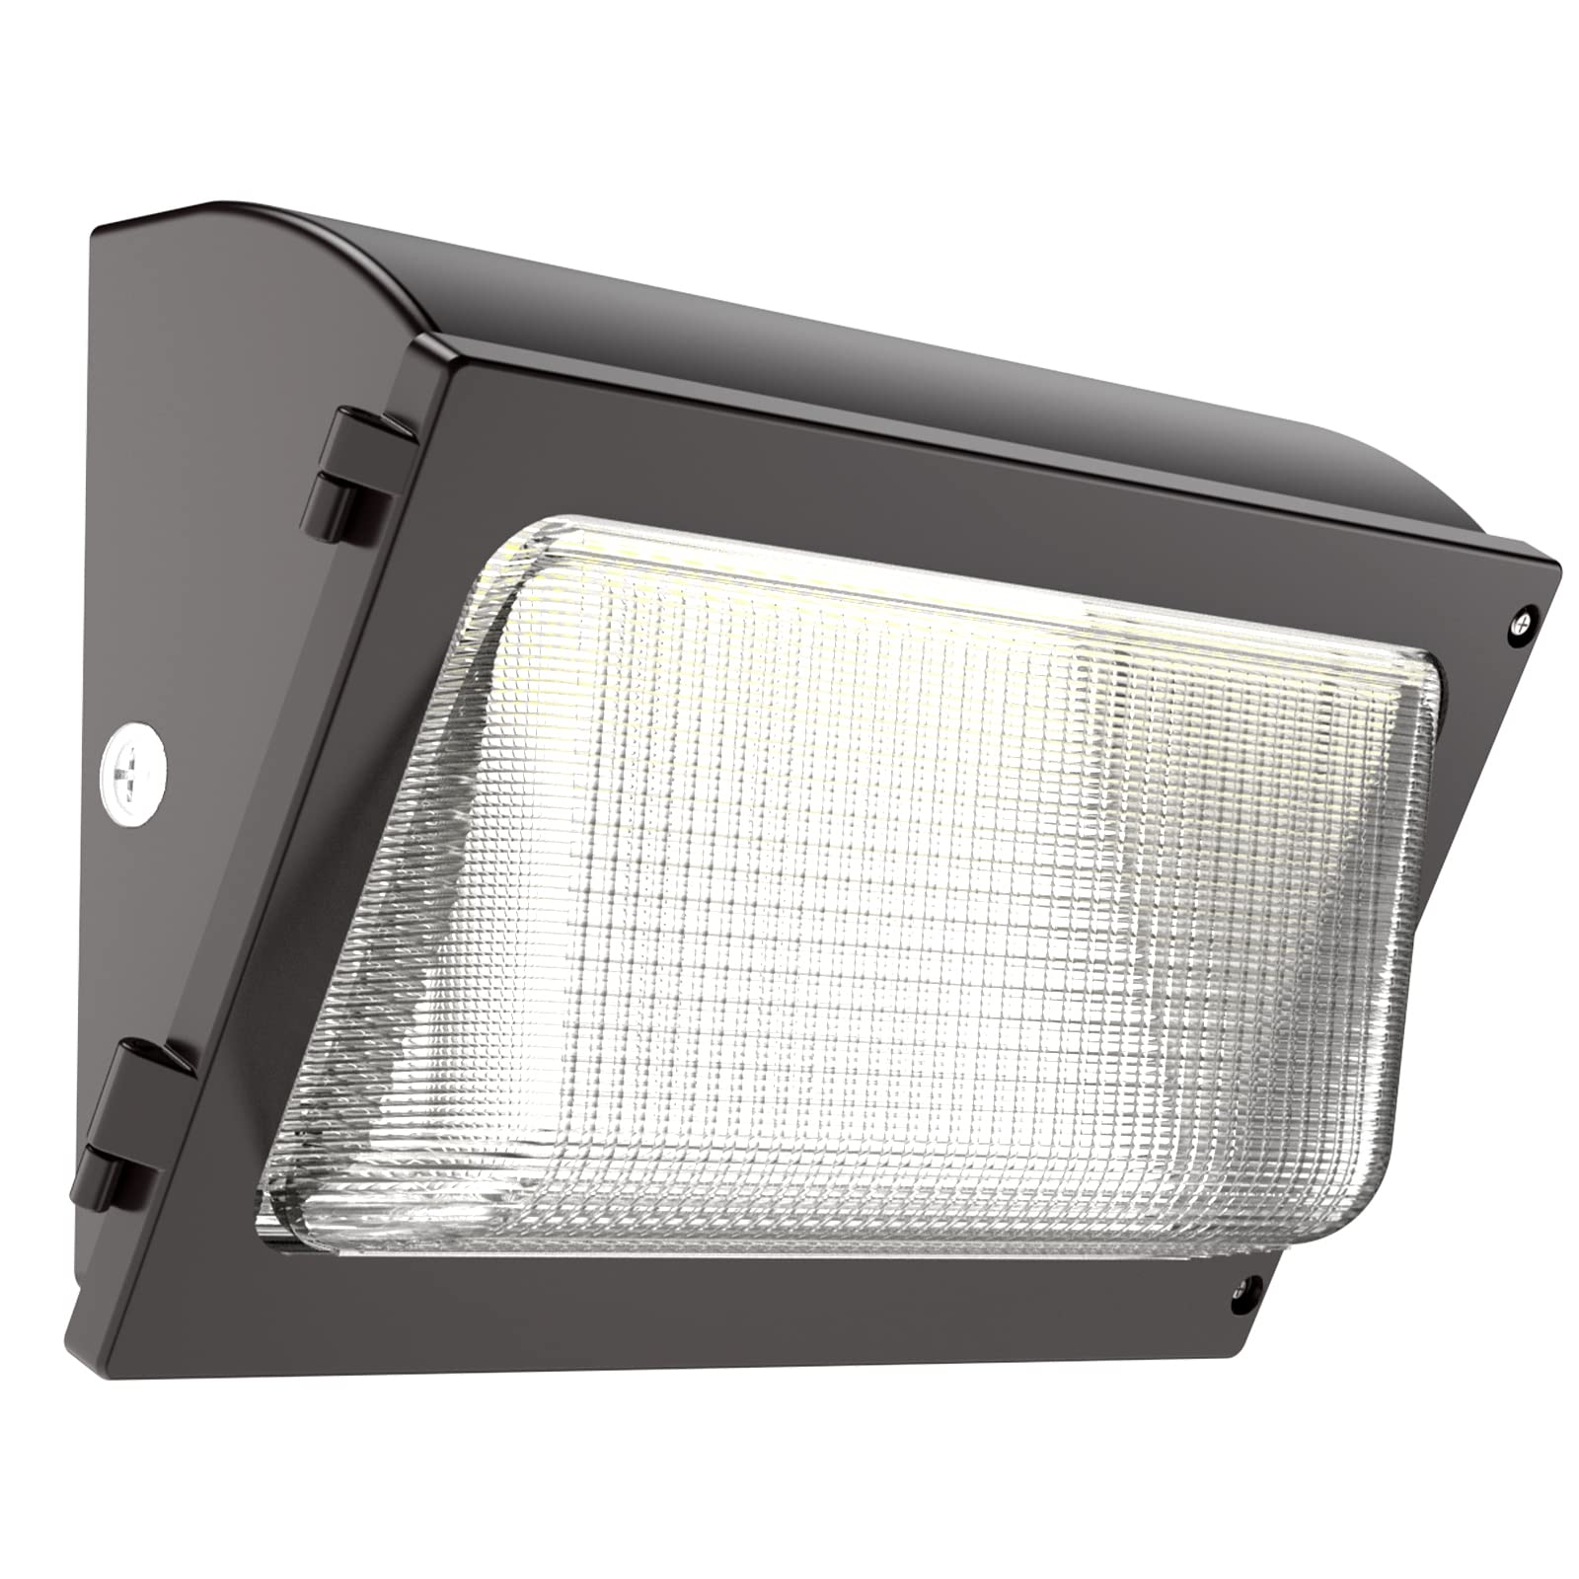
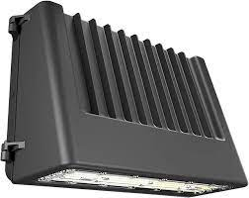
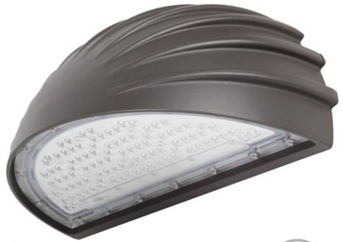
GOOD
BAD
DarkSky International | 2024

Slide 29
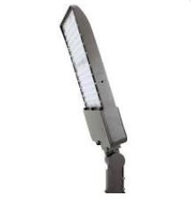
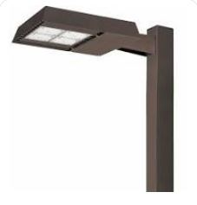
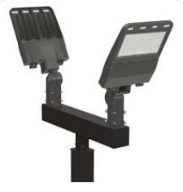
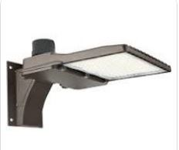
BAD
GOOD
DarkSky International | 2024

Slide 30
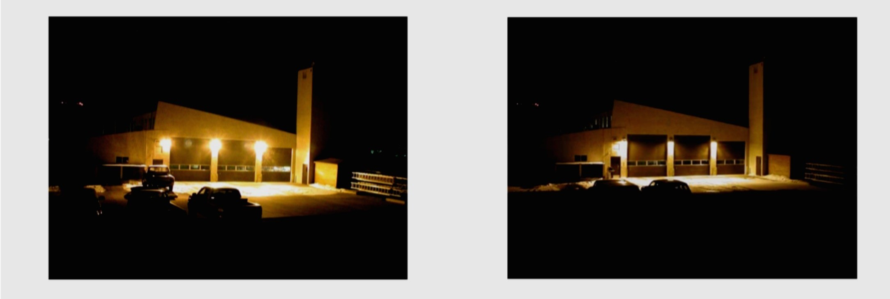
Positive Effects of Shielding
DarkSky International | 2024
Notes:
Aiming lights down at the task at hand dramatically reduces glare, increasing visibility and better illuminating the intended area. Shielding lights also means the need for use of less light, as you aren’t wasting it out into your neighbor’s window or up into the sky, therefore you can use less light at save yourself some money on your energy bill!

Slide 31
Notes:
Low level

Slide 32
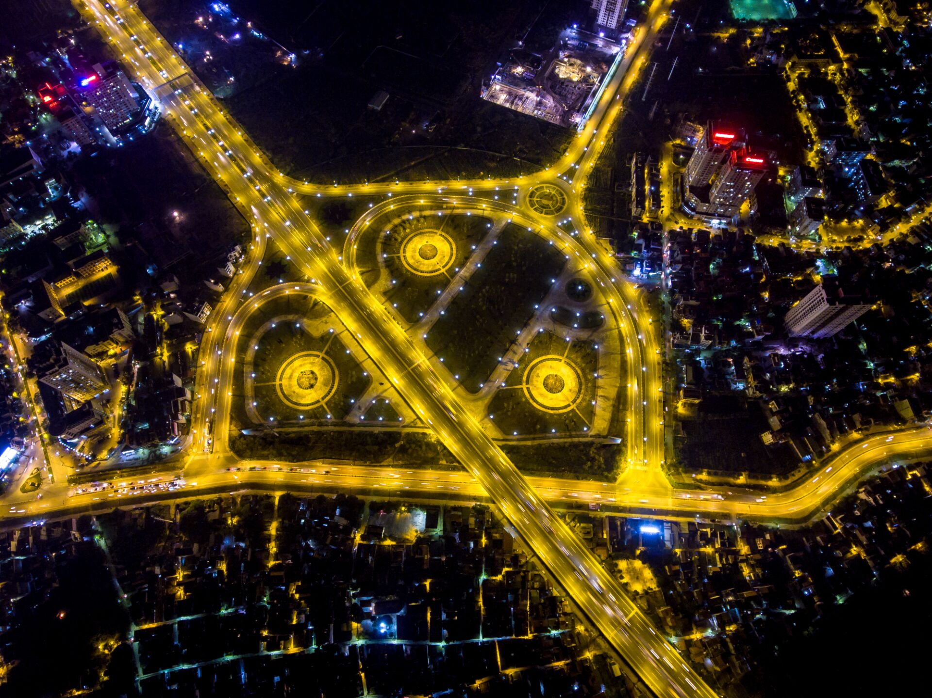
INTENSITY
DarkSky International | 2024
Notes:
Intensity is an often overlooked aspect of lighting design. Even if we shield every light, there will still be some light reflected up from the ground. To minimize this, only use the amount of light needed for the task at hand.

Slide 33
Notes:
Controls

Slide 34
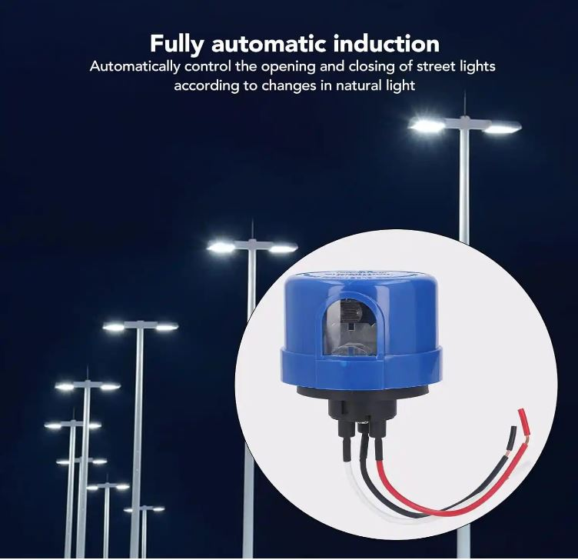
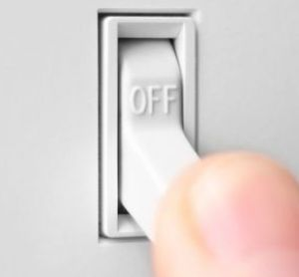

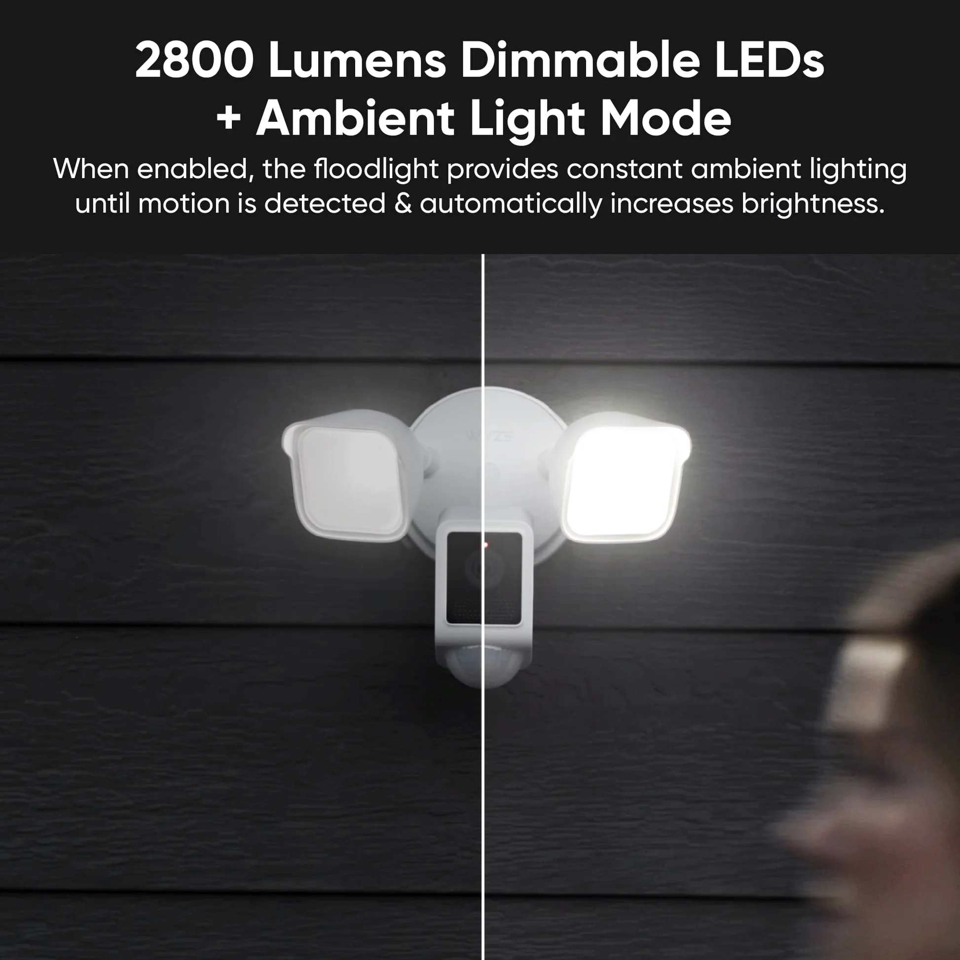
CONTROLS
We need to move beyond the photo-cell to more sophisticated controls...
Switches
Timers
Dimmers &
Motion Sensors
DarkSky International | 2024
Notes:
Controls are being under-utilized.

Slide 35
Notes:
Color temperature

Slide 36
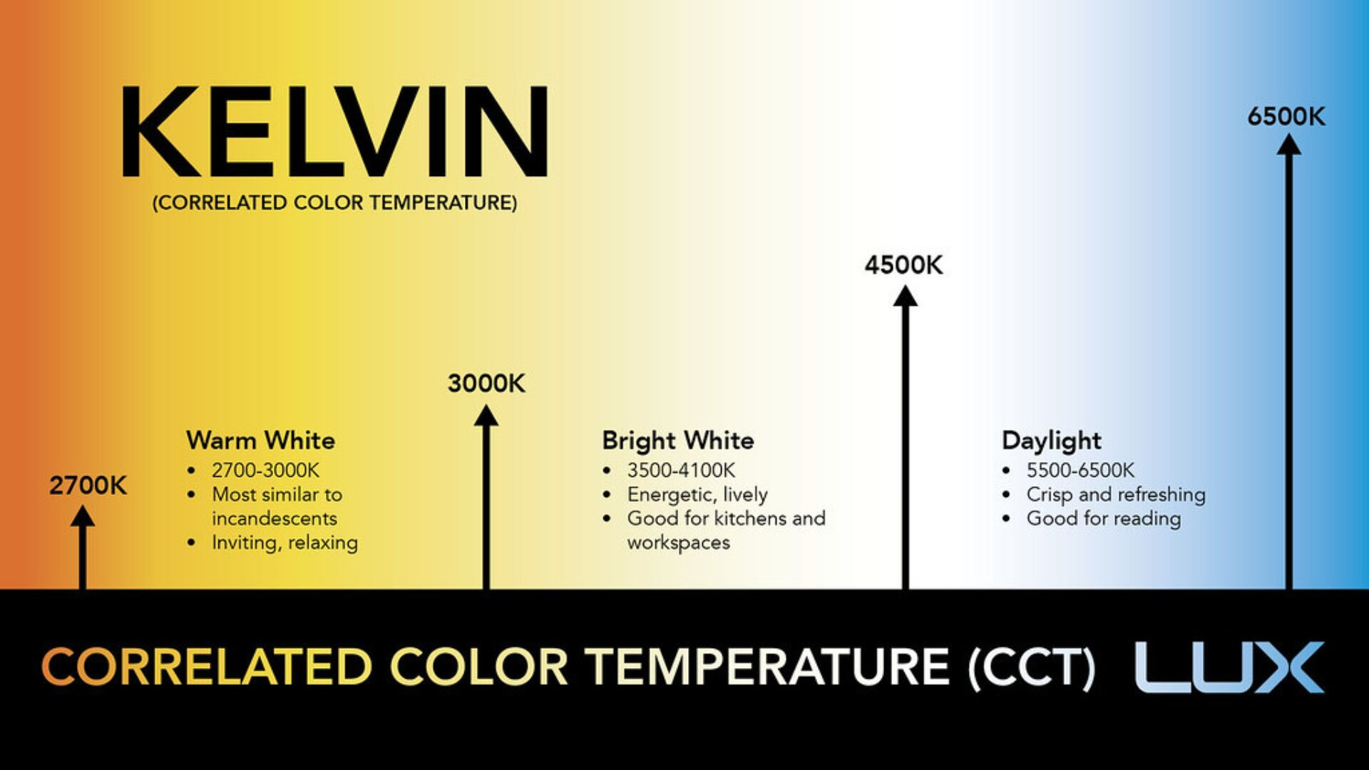
DarkSky International | 2024
Notes:
The color of light is important. Light color is measured in Kelvin, and dark sky best practices recommend only going as high as 3000 Kelvin to minimize the amount of blue in the light. This is healthier for human and environmental health. AMA recommendations include 3000K.

Slide 37
Notes:
These 5 principles are available to you here on this DarkSky information card.

Slide 38
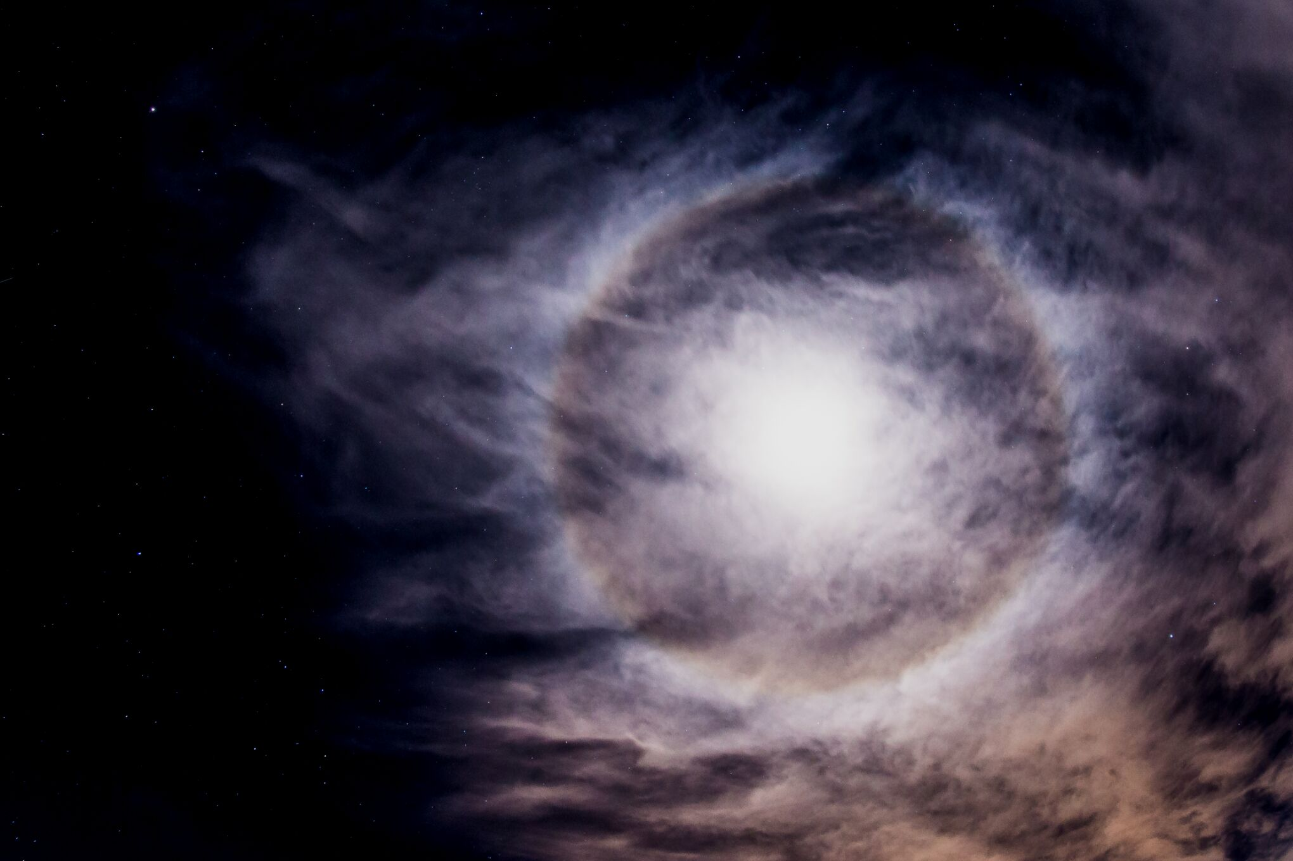
LIGHTING ORDINANCE
keep it dark
DarkSky International | 2024
Notes:
Lighting ordinances are ways that cities can ensure all of their lighting meet these criteria.
The Las Cruces ordinance is fairly good, but only enforced by complaint.

Slide 39
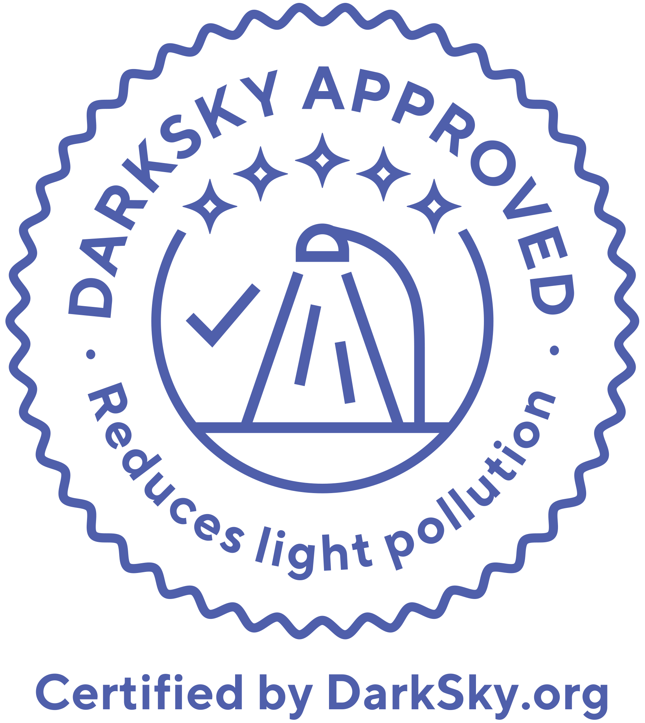
WHERE TO FIND THIS LIGHTING?
DarkSky Approved program
DarkSky International | 2024
Notes:
If you are looking for dark sky friendly lighting, check out DarkSky’s fixture seal of approval program! There is an online searchable database where you can find dark sky friendly lighting of all types.
Also, look for the seal when you are buying lighting at your local hardware store.

Slide 40
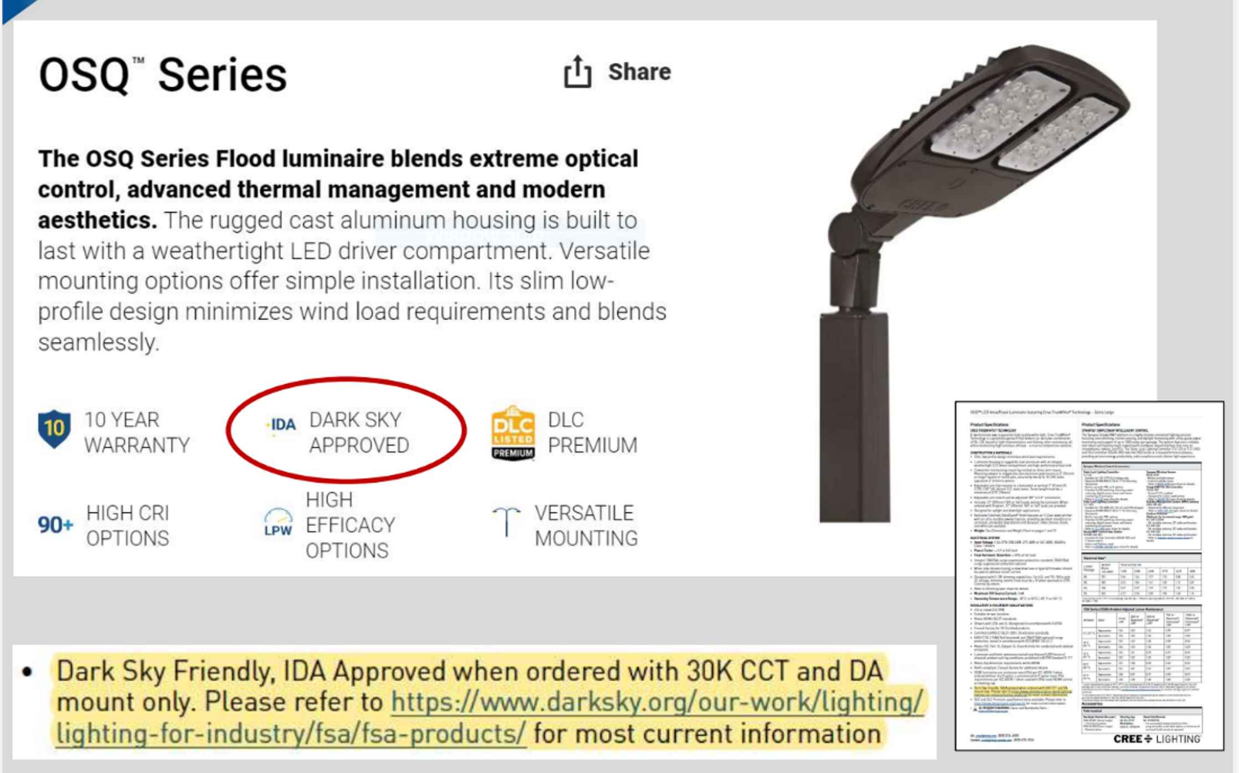
Notes:
But also keep in mind that some lighting is being marketed in a way that defeats the dark sky qualities.
This is an online ad for LED lighting, touting that this is dark-sky approved. However, as shown here it is NOT Darks Sky approved. You have to find the spec sheet elsewhere on the web site to see that it is actually only dark sky approved if it is on a fixed mount that is not angled up and if the color temperature of the light is 3000 K or less (warm).

Slide 41

The DarkSky International protects the night from light pollution and promotes responsible outdoor lighting.
WHO WE ARE
DarkSky International | 2024
Notes:
DarkSky International is a the leading organization working globally to protect the night.

Slide 42
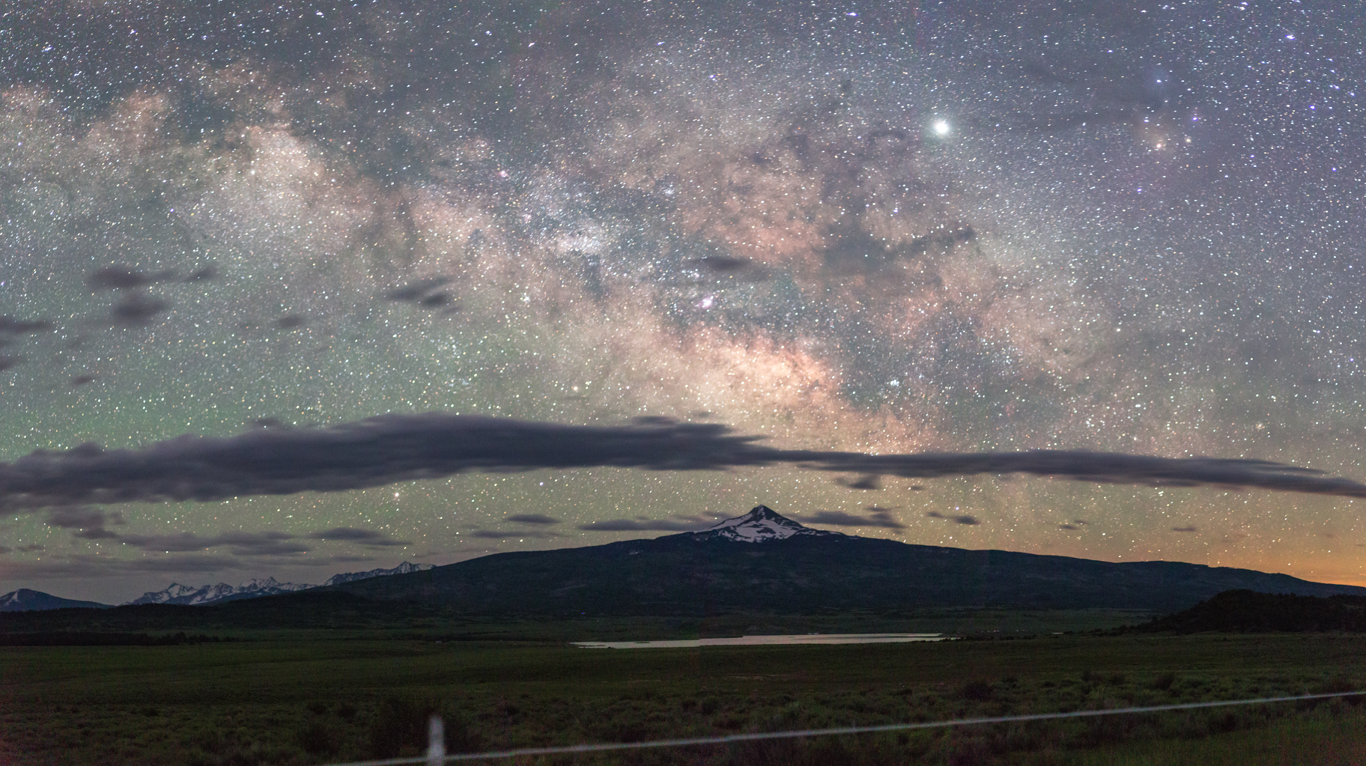
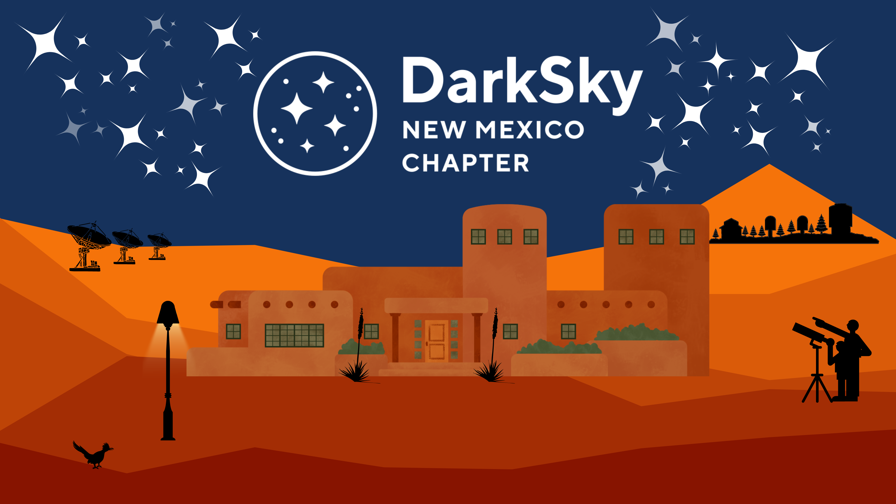
THANK YOU!
nmdarksky.org
Night photography: Bettymaya Foott
DarkSky International | 2024
Notes:
Thank you for your time tonight, and please reach out to me with any questions or if you are interested in being involved in the NM Chapter!

